Slide 1
Important factor to Consider on
Bipartite Link Prediction
Student’s Name: Bijay Gaudel
Student’s ID: SL1816018
Nanjing University of Aeronautics and Astronautics

Slide 2
Introduction
Objective of link prediction is to detect unabsorbed links from existing part of networks or forecast links from current structure of the networks.
Bipartite Network is one of the very important class in networks, which contains edges between two types of entities.
Nanjing University of Aeronautics and Astronautics
Notes:
Social networking is the grouping of individuals into specific groups, like small rural communities or a neighbourhood subdivision and the member of this groups interaction can take many forms like sharing links to interesting content produced by third party.

Slide 3
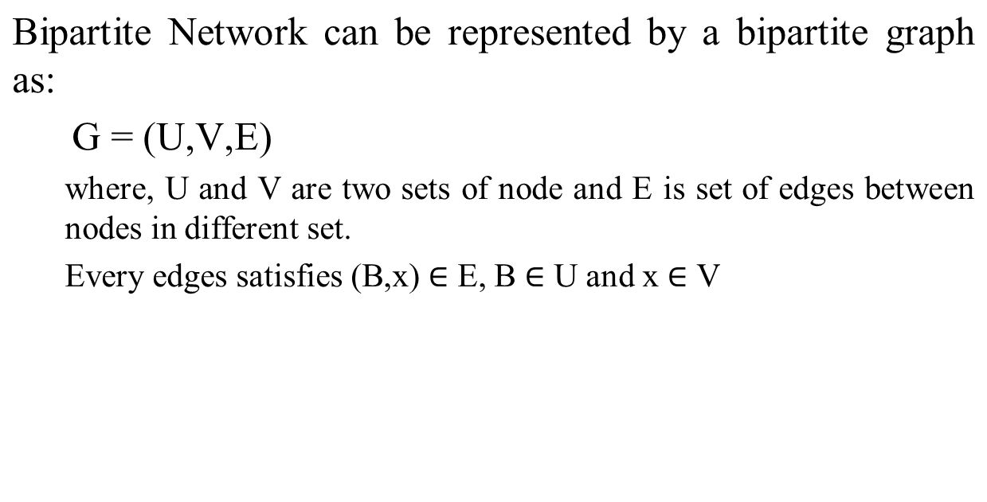
Projection of Bipartite Networks
Nanjing University of Aeronautics and Astronautics
Notes:
Social networking is the grouping of individuals into specific groups, like small rural communities or a neighbourhood subdivision and the member of this groups interaction can take many forms like sharing links to interesting content produced by third party.

Slide 4
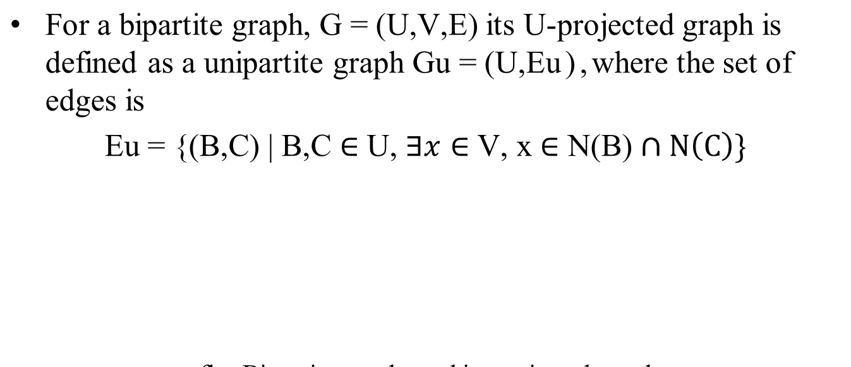
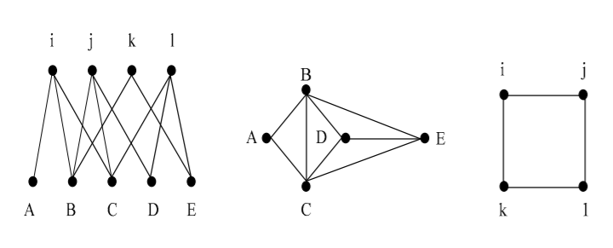
Projection of Bipartite Networks
Projected Graph
Nanjing University of Aeronautics and Astronautics
Notes:
Social networking is the grouping of individuals into specific groups, like small rural communities or a neighbourhood subdivision and the member of this groups interaction can take many forms like sharing links to interesting content produced by third party.

Slide 5
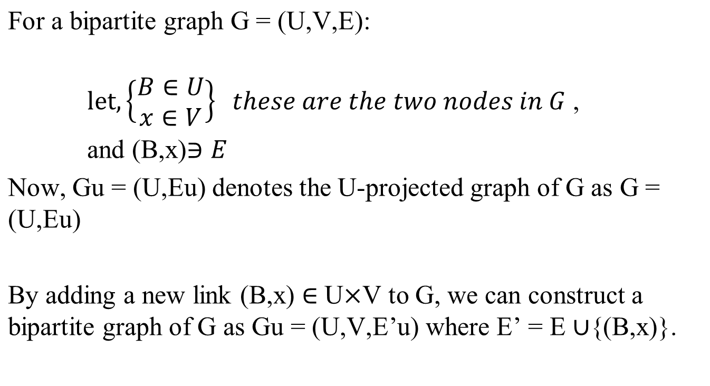
Candidate Node Pairs of the Pattern
Nanjing University of Aeronautics and Astronautics
Notes:
Link prediction is How a network evolves over time by looking at the snapshot of what is happening now and use that information to predict new connection and new collaboration in the future.

Slide 6
Candidate Node Pairs of the Pattern
Let G’u = (U,E’u) be the U-projected graph of G’ if Gu = G’u then (B,x) is a candidate node pair.
Nanjing University of Aeronautics and Astronautics
Notes:
Link prediction is How a network evolves over time by looking at the snapshot of what is happening now and use that information to predict new connection and new collaboration in the future.

Slide 7
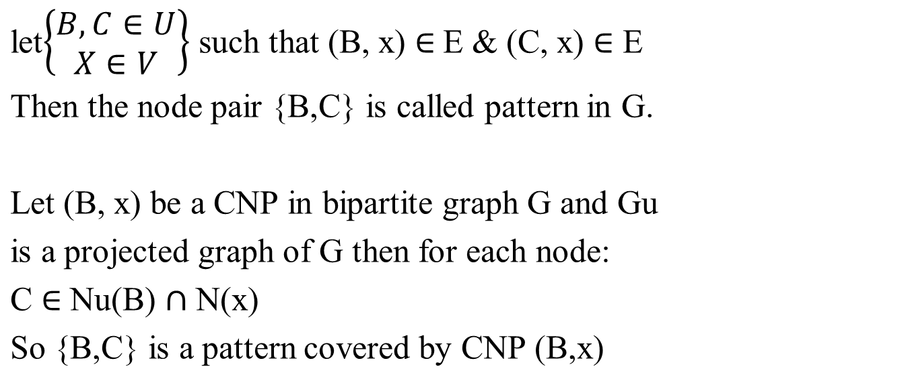
Pattern Covered by CNP’s
Nanjing University of Aeronautics and Astronautics
Notes:
Link prediction is How a network evolves over time by looking at the snapshot of what is happening now and use that information to predict new connection and new collaboration in the future.

Slide 8
Weight of the Pattern
We should consider three factors in calculating weight of the pattern
1) Number of Common Neighbors.
2) Degree of common Neighbors of node A and B
3) Degree of nodes A and B in Bipartite Graphs.
Nanjing University of Aeronautics and Astronautics
Notes:
Because the user keeps getting added exponentially.
To solve the link prediction problem, it needs to determine the formation or dissolution possibilities of links between all node pairs.
To predict the possible future link

Slide 9
Thank You
谢谢
Nanjing University of Aeronautics and Astronautics

